Slide 1
Sales & Revenue Performance Dashboard
Ecom Express Data Analysis using Power BI
Prepared by:
Jibin K B

Slide 2
Contents
Presentation Outline
Project Objective
Dataset Overview
Data Cleaning & Transformation
Data Model (Relationship View)
Measures Created (DAX)
Dashboard Overview
Key Insights
Dashboard Features
Conclusion
Future Enhancements

Slide 3
Project Objective
Analyze sales performance and revenue trends
Identify top-performing products and categories
Understand customer distribution across states
Measure the impact of order cancellations
Deliver actionable insights using interactive dashboards
This dashboard helps stakeholders make data-driven business decisions efficiently.

Slide 4
Dataset Overview
The project uses three core datasets of Ecom Express:
Customers Table
CustomerID
Full Name
Phone
City
State
OS (Android / iOS)
Phone Brand
Products Table
ProductID
Product Name
Category
Price
Rating
Number of people who rated the product
Orders Table
OrderID
CustomerID
ProductID
Quantity
Date & Time of Purchase
Delivery Status

Slide 5
Data Cleaning & Transformation
Customer Table
Combined first name and last name → Full Name
Standardized city names (capitalized)
Classified OS type:
  Apple → iOS
  Others → Android

Slide 6
Data Cleaning & Transformation
Product Table
Converted Price to fixed decimal format
Data Modeling
Created relationships:
  Products → Orders (ProductID)
  Customers → Orders (CustomerID)

Slide 7
Data Model
Model Design
Star schema structure
Orders as fact table
Customers and Products as dimension tables
Benefits
Improved query performance
Accurate filtering
Better analytical clarity

Slide 8
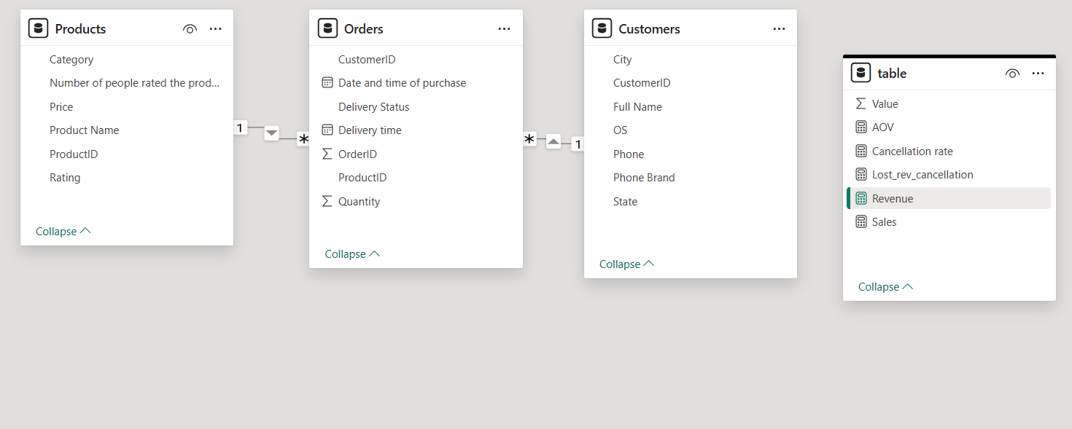
Data Model

Slide 9
Measures Created (DAX)
Sales
Sales = SUMX(Orders, Orders[Quantity] * RELATED(Products[Price]))
Lost Revenue Due to Cancellation
Lost_rev_cancellation =
CALCULATE([Sales], Orders[Delivery Status] = "Cancelled")
Revenue
Revenue = [Sales] - [Lost_rev_cancellation]

Slide 10
Measures Created (DAX)
Cancellation Rate
Cancellation rate =
DIVIDE(
CALCULATE(COUNTROWS(Orders), Orders[Delivery Status] = "Cancelled"),
COUNTROWS(Orders)
)

Slide 11
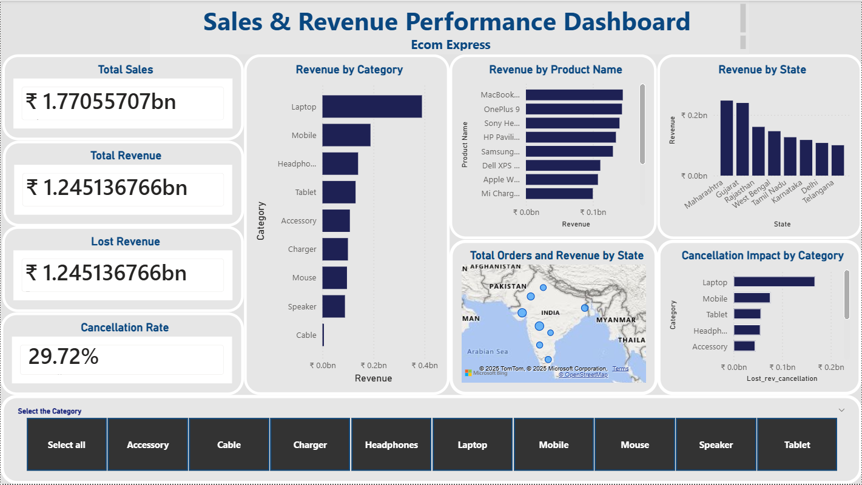
Dashboard Overview

Slide 12
Dashboard Overview
Dashboard Includes:
Cards:
  Sales
  Revenue
  Lost Revenue
  Cancellation Rate
Revenue analysis by:
  State
  Category
  Product
Monthly revenue trend
Category-based slicer for filtering

Slide 13
Key Insights
Laptop and Mobile categories generate the highest revenue
Top-performing states: Maharashtra, Gujarat, Rajasthan
Cancellation rate (~30%) significantly impacts revenue
Revenue shows seasonal variation across months
High-value products generate more revenue despite fewer orders

Slide 14
Dashboard Features
Interactive Capabilities
Dynamic filtering using category slicers
Real-time card updates
Drill-down across products and regions
Clear and user-friendly visualization design

Slide 15
Conclusion
Key Takeaways
Dashboard provides clear visibility into business performance
Helps identify revenue loss due to cancellations
Supports better inventory and sales planning
Designed to be scalable for future enhancements

Slide 16
Future Enhancements
Predictive analytics (sales forecasting)
Customer Lifetime Value (CLV) calculation
Integration with real-time or streaming data

Slide 17
Thank you

